Slide 1

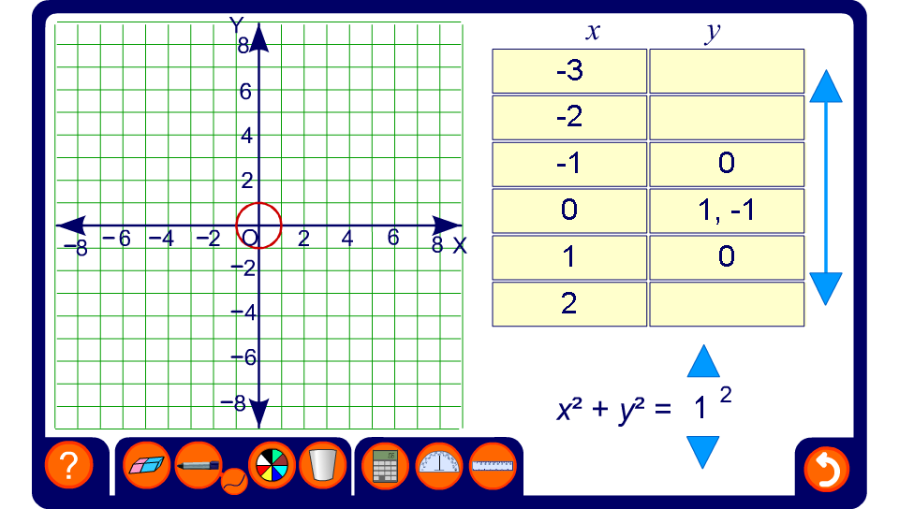


Exploring the graph of a circle
Notes:
Explore the graphs of circles of various radii. Establish that the equation holds for every point on the circle using Pythagoras’ Theorem.
Note that the table of values gives two values for y. This means that x² + y² = r² is not a function, since functions may only map each value of x onto a unique value of y.
The relationship x² + y² = r² is called a locus since it describes the points on a given path, in this case a circle.

